Slide 1
Homework Assignment 3
Digital Image Processing
Deadline: 9:00 AM, Thursday, 10/24/2024

Slide 2
Problem 1 (35%)
The purpose of this homework is to exercise filtering in the frequency domain. You are asked to write your own code to remove the periodic noise from the image shown in Fig. 4.65(a) on page 305 of the textbook. But you may use an existing library to compute Fourier transform.
Fig0465(a).tif

Slide 3
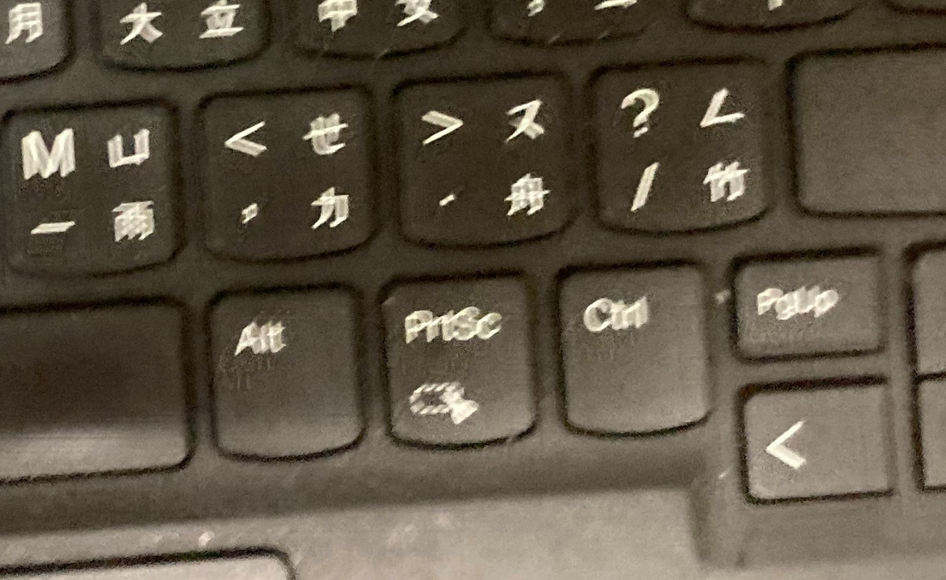
Problem 2 (65%)
The image “motion blur_1” is corrupted by motion blur, as illustrated in the left figure. We do not have any information of the motion. From the figure, however, you can tell that different parts of the keyboard seem to have different degrees of blur, perhaps because the camera used to capture the image is at a slant angle with respect to the keyboard. You are asked to restore the image by all means you can think off. (35%)
Use your smartphone to generate a blur image corrupted by a linear motion and design your own technique to restore the image. (30%)
motion blur_1.jpg

Slide 4
Software Package Allowed
Python 3.8+
Standard Python library
Numpy 1.21.1
Opencv-python 4.5.1
Matplotlib 3.6.0

Slide 5
Assignment Requirements
All functions in the Software Package are allowed.
Set your directory structure as follows:
r109XXXXX/
- p1.py
- p2.py
- report.pdf
- images/
- Fig0465(a).tif, motion_blur_1.jpg
- Images of program output

Slide 6
Assignment Submission Requirements
Submit to NTU COOL
Do NOT copy homework (code, report, results, etc.) from others

